Slide 1

From Mess to Model: Mastering Data Preparation
CS 180 Introduction to Data Science
AkA Data Wrangling

Slide 2
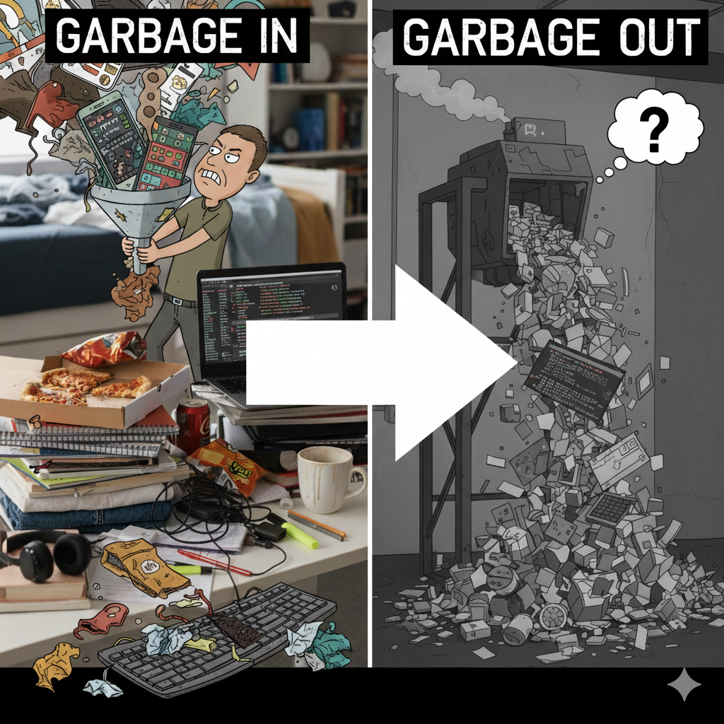
Why is Data Preparation so Important?
Garbage IN – Garbage OUT
Impacts model accuracy and reliability.
A model is only as good as the data it learns from.
Ensures trust in insights
Data scientists spend ~70-80% of their time cleaning and preparing data

Slide 3
Learning Objectives
By the end of this lesson, students will be able to:
Understand the importance of data preparation in the overall data science lifecycle.
Explain why data preparation is critical to successful data science projects.
Identify and apply standard techniques for cleaning datasets.
Learn key data transformation and feature engineering techniques using Python.

Slide 4
Data Preparation Concepts for Today
Data Profiling
Data Cleaning
Missing Values
Inconsistencies
Duplicates
Outliers
Data Transformation
Standardization
Normalization
Aggregation (e.g., Groupby)
Pivot Table
Contingency Table or Crosstab

Slide 5

Review: The 6S5P Data Science Lifecycle
Define Problem
Manage-Measure
Acquire Data
Data Platform
Focus for the next few weeks
Deploy Model
Prepare Data
Build Model
Notes:
The Six Stage Five Phase Lifecycle:
I was struggling to create a visual analogy for explaining the Data Science Lifecycle. Then I saw my 9 month old grandson playing with his donut shaped stacking toys.
Bingo! It was the perfect analogy for illustrating the 3-dimenstional nature of the DS lifecycle that has both stages and phases.
The Data Science lifecycle is similar in many ways to the SDLC but also subtly different. What differences to you see? Why do we have these differences for Data Science applications?
This structure is unique to my experience. By having both phases and stages we can better capture the evolution of applications as they move from initial concepts to full production.

Slide 6
2. Identify and Acquire the Data
Source Data
Run | Type | Accuracy | Precision | Sensitivity | Acc+Sen
1 | Binary | 91.00% | 47.00% | 0.25% | 94.00%
2 | Binary | 78.00% | 22.00% | 1.00% | 94.40%
3 | Binary | 51.00% | 43.65% | 0.15% | 94.04%
4 | Binary | 91.00% | None | 0.00% | 94.00%
5 | Binary | 91.00% | None | 0.00% | 94.00%
6 | Binary | 92.00% | None | 0.00% | #VALUE!
7 | Binary | 91.00% | None | 0.00% | 82.40%
8 | Binary | 91.00% | None | 0.00% | 82.42%
9 | Binary | 91.00% | None | 0.00% | 84.52%
10 | Binary | 91.00% | 25.00% | 0.61% | 82.78%
11 | Binary | 77.00% | 20.37% | 64.56% | 84.57%
Billing Table
Run | Type | Accuracy | Precision | Sensitivity | Acc+Sen
1 | Binary | 91.00% | 47.00% | 0.25% | 94.00%
2 | Binary | 78.00% | 22.00% | 1.00% | 94.40%
3 | Binary | 51.00% | 43.65% | 0.15% | 94.04%
4 | Binary | 91.00% | None | 0.00% | 94.00%
5 | Binary | 91.00% | None | 0.00% | 94.00%
6 | Binary | 92.00% | None | 0.00% | #VALUE!
7 | Binary | 91.00% | None | 0.00% | 82.40%
8 | Binary | 91.00% | None | 0.00% | 82.42%
9 | Binary | 91.00% | None | 0.00% | 84.52%
10 | Binary | 91.00% | 25.00% | 0.61% | 82.78%
11 | Binary | 77.00% | 20.37% | 64.56% | 84.57%
Leverage Data Catalog to ID relevant data
Use ETL# tools, processes
Join data sources (often using SQL)
Data Type checking
Schema Matching
Output: Raw Analytic Data Set or View
Call Center Table
Run | Type | Accuracy | Precision | Sensitivity | Acc+Sen
1 | Binary | 91.00% | 47.00% | 0.25% | 94.00%
2 | Binary | 78.00% | 22.00% | 1.00% | 94.40%
3 | Binary | 51.00% | 43.65% | 0.15% | 94.04%
4 | Binary | 91.00% | None | 0.00% | 94.00%
5 | Binary | 91.00% | None | 0.00% | 94.00%
6 | Binary | 92.00% | None | 0.00% | #VALUE!
7 | Binary | 91.00% | None | 0.00% | 82.40%
8 | Binary | 91.00% | None | 0.00% | 82.42%
9 | Binary | 91.00% | None | 0.00% | 84.52%
10 | Binary | 91.00% | 25.00% | 0.61% | 82.78%
11 | Binary | 77.00% | 20.37% | 64.56% | 84.57%
Customer Profile Table
Web Activity Table
Run | Type | Accuracy | Precision | Sensitivity | Acc+Sen
1 | Binary | 91.00% | 47.00% | 0.25% | 94.00%
2 | Binary | 78.00% | 22.00% | 1.00% | 94.40%
3 | Binary | 51.00% | 43.65% | 0.15% | 94.04%
4 | Binary | 91.00% | None | 0.00% | 94.00%
5 | Binary | 91.00% | None | 0.00% | 94.00%
6 | Binary | 92.00% | None | 0.00% | #VALUE!
7 | Binary | 91.00% | None | 0.00% | 82.40%
8 | Binary | 91.00% | None | 0.00% | 82.42%
9 | Binary | 91.00% | None | 0.00% | 84.52%
10 | Binary | 91.00% | 25.00% | 0.61% | 82.78%
11 | Binary | 77.00% | 20.37% | 64.56% | 84.57%
Raw ADS
Potential variables required to solve business problem
Very wide data set
Derived, Joined and Lightly Transformed
A | B | C | D | E | F | G | H | I | J | K | L | M
Acct ID | Att 1 | Att 2 | Number | Add | Age | SSN | SSN | SSN | SSN | SSN | SSN | SSN
12345 | ajklfff | 33efjgkl | 33efjgk | 33efjgkl | 33efjgkl | 33efjgkl | 33efjg | 33efj | 33ef | 33ef | 33ef | 33ef
12346 | ajklfff | 33efjgkl | 33efjgk | 33efjgkl | 33efjgkl | 33efjgkl | fjfkl | 123 | kjj | 666 | 4236 | 4425
12347 | ajklfff | 33efjgkl | 33efjgk | 33efjgkl | 33efjgkl | 33efjgkl | fjfkl | 123 | kjj | 666 | 4236 | 4425
12348 | ajklfff | 33efjgkl | 33efjgk | 33efjgkl | 33efjgkl | 33efjgkl | fjfkl | 123 | kjj | 666 | 4236 | 4425
12349 | ajklfff | 33efjgkl | efjgklk | 33efjgkl | 33efjgkl | 33efjgkl | fjfkl | 123 | kjj | 666 | 4236 | 4425
12350 | ajklfff | 33efjgkl | 33efklk | 33efjgkl | 33efjgkl | 33efjgkl | fjfkl | 123 | kjj | 666 | 4236 | 4425
12351 | ajklfff | 33efjgkl | #%$GG | 33efjgkl | 33efjgkl | 33efjgkl | fjfkl | 123 | kjj | 666 | 4236 | 4425
Notes:
*Minimum Viable Product
# Extract, Transform, Load

Slide 7
3. Understand and Prepare the Data
Modeling Ready ADS
A | C | E | F | K | M
Acct ID | Att 2 | Att 31 | Age | SSN | REV
12345 | 33efjgkl | 33efjgkl | 33efjgkl | 33ef | 33ef
12346 | 33efjgkl | 33efjgkl | 33efjgkl | 666 | 4425
12347 | 33efjgkl | 33efjgkl | 33efjgkl | 666 | 4425
12348 | 33efjgkl | 33efjgkl | 33efjgkl | 666 | 4425
12349 | 33efjgkl | 33efjgkl | 33efjgkl | 666 | 4425
12350 | 33efjgkl | 33efjgkl | 33efjgkl | 666 | 4425
12351 | 33efjgkl | 33efjgkl | 33efjgkl | 666 | 4425
12345 | 33efjgkl | 33efjgkl | 33efjgkl | 33ef | 2223
12346 | 33efjgkl | 33efjgkl | 33efjgkl | 666 | 4425
12347 | 33efjgkl | 33efjgkl | 33efjgkl | 666 | 4425
12348 | 33efjgkl | 33efjgkl | 33efjgkl | 666 | 4425
12349 | 33efjgkl | 33efjgkl | 33efjgkl | 666 | 4425
12350 | 33efjgkl | 33efjgkl | 33efjgkl | 666 | 4425
12351 | 33efjgkl | 33efjgkl | 33efjgkl | 666 | 4425
2345 | Fjlkd | Jlkjf | Fjfjf | 345 | 0123
Run | Type | Accuracy | Precision | Sensitivity | Acc+Sen
1 | Binary | 91.00% | 47.00% | 0.25% | 94.00%
2 | Binary | 78.00% | 22.00% | 1.00% | 94.40%
3 | Binary | 51.00% | 43.65% | 0.15% | 94.04%
4 | Binary | 91.00% | None | 0.00% | 94.00%
5 | Binary | 91.00% | None | 0.00% | 94.00%
6 | Binary | 92.00% | None | 0.00% | #VALUE!
7 | Binary | 91.00% | None | 0.00% | 82.40%
8 | Binary | 91.00% | None | 0.00% | 82.42%
9 | Binary | 91.00% | None | 0.00% | 84.52%
10 | Binary | 91.00% | 25.00% | 0.61% | 82.78%
11 | Binary | 77.00% | 20.37% | 64.56% | 84.57%
Profile Data
Clean Data (missing / corrupted values)
Outlier Analysis
Transform Data
Generate New Features
Visualize Data
Analyze Data (*EDA)
Create Analytic Data Set (ADS)
Billing Table
Run | Type | Accuracy | Precision | Sensitivity | Acc+Sen
1 | Binary | 91.00% | 47.00% | 0.25% | 94.00%
2 | Binary | 78.00% | 22.00% | 1.00% | 94.40%
3 | Binary | 51.00% | 43.65% | 0.15% | 94.04%
4 | Binary | 91.00% | None | 0.00% | 94.00%
5 | Binary | 91.00% | None | 0.00% | 94.00%
6 | Binary | 92.00% | None | 0.00% | #VALUE!
7 | Binary | 91.00% | None | 0.00% | 82.40%
8 | Binary | 91.00% | None | 0.00% | 82.42%
9 | Binary | 91.00% | None | 0.00% | 84.52%
10 | Binary | 91.00% | 25.00% | 0.61% | 82.78%
11 | Binary | 77.00% | 20.37% | 64.56% | 84.57%
Call Center Table
Run | Type | Accuracy | Precision | Sensitivity | Acc+Sen
1 | Binary | 91.00% | 47.00% | 0.25% | 94.00%
2 | Binary | 78.00% | 22.00% | 1.00% | 94.40%
3 | Binary | 51.00% | 43.65% | 0.15% | 94.04%
4 | Binary | 91.00% | None | 0.00% | 94.00%
5 | Binary | 91.00% | None | 0.00% | 94.00%
6 | Binary | 92.00% | None | 0.00% | #VALUE!
7 | Binary | 91.00% | None | 0.00% | 82.40%
8 | Binary | 91.00% | None | 0.00% | 82.42%
9 | Binary | 91.00% | None | 0.00% | 84.52%
10 | Binary | 91.00% | 25.00% | 0.61% | 82.78%
11 | Binary | 77.00% | 20.37% | 64.56% | 84.57%
Customer Profile Table
Web Activity Table
Run | Type | Accuracy | Precision | Sensitivity | Acc+Sen
1 | Binary | 91.00% | 47.00% | 0.25% | 94.00%
2 | Binary | 78.00% | 22.00% | 1.00% | 94.40%
3 | Binary | 51.00% | 43.65% | 0.15% | 94.04%
4 | Binary | 91.00% | None | 0.00% | 94.00%
5 | Binary | 91.00% | None | 0.00% | 94.00%
6 | Binary | 92.00% | None | 0.00% | #VALUE!
7 | Binary | 91.00% | None | 0.00% | 82.40%
8 | Binary | 91.00% | None | 0.00% | 82.42%
9 | Binary | 91.00% | None | 0.00% | 84.52%
10 | Binary | 91.00% | 25.00% | 0.61% | 82.78%
11 | Binary | 77.00% | 20.37% | 64.56% | 84.57%
A | B | C | D | E | F | G | H | I | J | K | L | M
Acct ID | Att 1 | Att 2 | Number | Add | Age | SSN | SSN | SSN | SSN | SSN | SSN | SSN
12345 | ajklfff | 33efjgkl | 33efjgk | 33efjgkl | 33efjgkl | 33efjgkl | 33efjg | 33efj | 33ef | 33ef | 33ef | 33ef
12346 | ajklfff | 33efjgkl | 33efjgk | 33efjgkl | 33efjgkl | 33efjgkl | fjfkl | 123 | kjj | 666 | 4236 | 4425
12347 | ajklfff | 33efjgkl | 33efjgk | 33efjgkl | 33efjgkl | 33efjgkl | fjfkl | 123 | kjj | 666 | 4236 | 4425
12348 | ajklfff | 33efjgkl | 33efjgk | 33efjgkl | 33efjgkl | 33efjgkl | fjfkl | 123 | kjj | 666 | 4236 | 4425
12349 | ajklfff | 33efjgkl | efjgklk | 33efjgkl | 33efjgkl | 33efjgkl | fjfkl | 123 | kjj | 666 | 4236 | 4425
12350 | ajklfff | 33efjgkl | 33efklk | 33efjgkl | 33efjgkl | 33efjgkl | fjfkl | 123 | kjj | 666 | 4236 | 4425
12351 | ajklfff | 33efjgkl | #%$GG | 33efjgkl | 33efjgkl | 33efjgkl | fjfkl | 123 | kjj | 666 | 4236 | 4425
Notes:
* Exploratory Data Analysis

Slide 8
Pandas Data Profiling
Function | Purpose | Best For | Output
df.info() | Provides a technical summary of the DataFrame. | Quickly checking data types and finding columns with missing values. | A text summary of columns, non-null counts, and data types.
df.describe() | Generates descriptive statistics for numerical columns. | Understanding the distribution, scale, and potential outliers of numerical data. | A table of statistics (mean, median, min, max, etc.).
df.isnull().sum() | Counts the exact number of missing (NaN) values in each column. | Quantifying the severity of missing data for each feature. | A Series showing each column name and its null count.
df['col'].value_counts() | Counts the unique values in a categorical column. | Analyzing the distribution of categories and spotting inconsistencies. | A Series of unique values and their frequencies.
df.duplicated().sum() | Counts the total number of duplicate rows. | Checking for data redundancy and integrity issues. | A single integer representing the number of duplicate rows.

Slide 9
Automated Data Profiling
These libraries are designed to give you a comprehensive overview of your dataset with minimal code, saving you a significant amount of time during the initial exploratory phase.
ydata-profiling: The most popular choice for generating a detailed, interactive HTML report that covers everything from missing values and correlations to data distributions.
Sweetviz: Excellent for creating beautiful, visual reports and is especially powerful for comparing two datasets (like a training and a testing set).

Slide 10
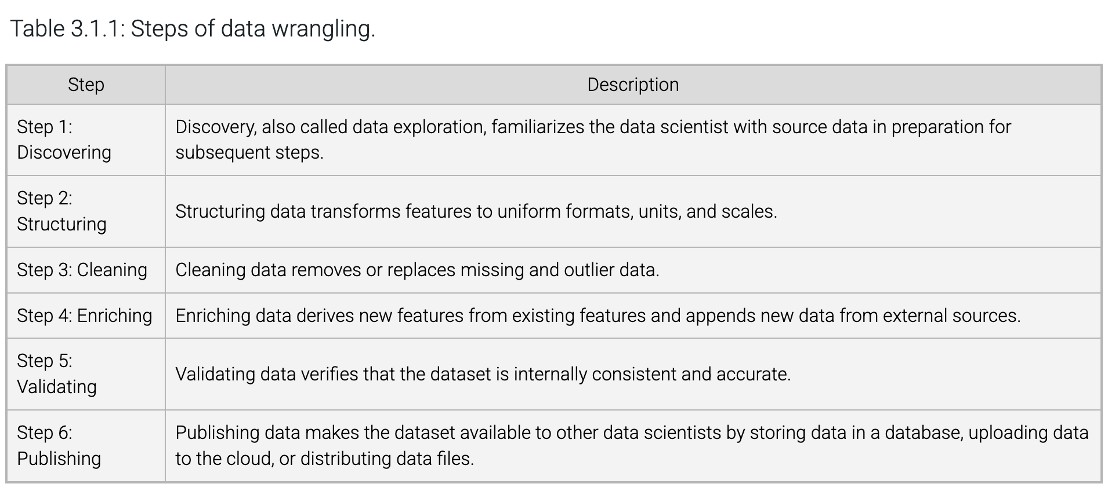
The zyBook Data Preparation Process
Not in the correct sequence. You should not do any transformations on the data until after it has been initially cleaned. Otherwise, you are wasting operations and may generate errors

Slide 11
The Updated Data Preparation Process
Step | Description
Step 1: Profiling | Data Profiling, also called data exploration, familiarizes the data scientist with source data in preparation for subsequent steps.
Step 2: Cleaning | Cleaning data removes or replaces missing and outlier data.
Step 3: Feature Gen | Enriching data derives new features from existing features and appends new data from external sources.
Step 4: Transform | Structuring data transforms to uniform formats, units, and scales.
Step 5: Validating | Validating data verifies that the dataset is internally consistent and accurate.
Step 6: Publishing | Publishing data makes the dataset available to other data scientists by storing data in a database, uploading data to the cloud, or distributing data files.
This is an iterative process. As new features/data are received, cycle through each step again.

Slide 12
Data Cleaning
Missing Values
Code snippet with fillna().
Visual: Table before/after missing value imputation.
Inconsistencies
Example: “CA” vs “California.”
Visual: Table showing cleaned categories.
Duplicates
Code: drop_duplicates().
Visual: Highlight duplicate rows.
Outliers
Z-score detection.
Visual: Boxplot before/after removing outliers.

Slide 13
Data Transformation & Feature Engineering
Feature Scaling: Normalization vs Standardization
Code: MinMaxScaler vs StandardScaler.
Aggregation
Example: Sales per month.
Feature Engineering
Example: “DayOfWeek” from timestamp.

Slide 14
Feature Scaling: Normalization vs. Standardization
A dataset's numeric features often have different scales, and in some datasets, scales may differ by orders of magnitude.
This incongruity may bias some algorithms by giving more weight to larger numbers.
Feature scaling converts numeric features to uniform ranges. Two of the most common feature scaling methods are standardization and normalization.

Slide 15
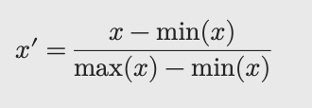
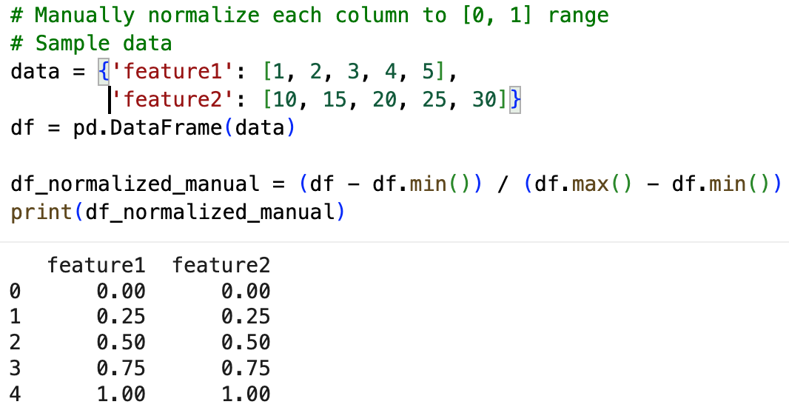
Normalization (AKA MIN-Max scaling)
There are many types of data “normalization”
Min-Max Normalization scales values between [0, 1] using the following formula:

Slide 16
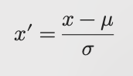
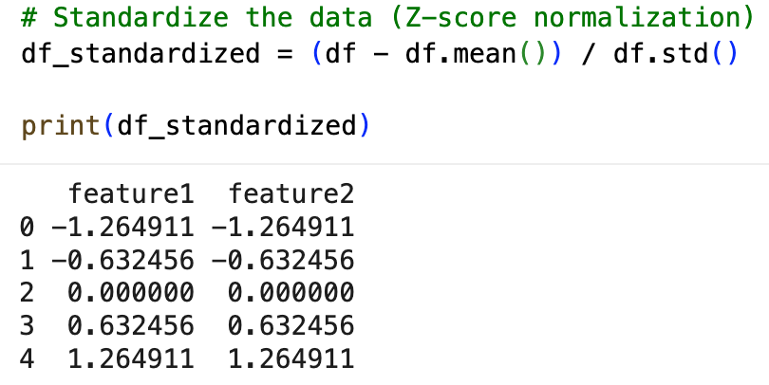
Standardization (AKA z-score normalization)
Rescales value to have a mean of 0 and standard deviation of 1:

Slide 17
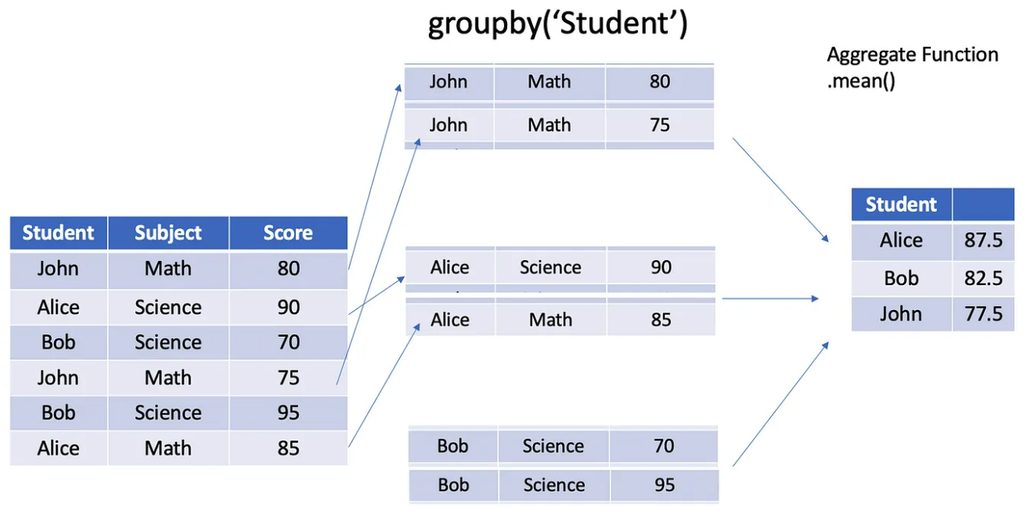
Groupby
The groupby() function in pandas is one of the most powerful and frequently used tools for data analysis.
The process is best understood by the term "Split-Apply-Combine."
Split: The data is split into groups based on some criteria (e.g., all rows with the same student).
Apply: A function is applied to each group independently (e.g., mean score for each student).
Combine: The results of these operations are combined into a new DataFrame or Series.

Slide 18
Pivot Table
df.pivot_table() takes several parameters.
value specifies the values in the pivot table's elements.
The feature in the pivot table's rows is specified using index and the feature in the pivot table's columns is columns.
aggfunc specifies a function to apply to the values in each row/column combination within the pivot table.
The default aggregate function is np.mean. Other functions include: sum, count, min, max, median, mode, var (variance), first, last, size, custom functions (e.g., aggfunc=lambda x: x.max() - x.min()
You can also apply multiple aggregation functions by passing them as a list: pd.pivot_table(df, values='Sales', index='Region', aggfunc=['mean', 'sum', 'count'])

Slide 19
Crosstab / contingency / Frequency Table
Purpose: Primarily used to calculate the frequency (or other statistics) between two or more categorical variables.
Default Output: Crosstabs typically result in contingency tables, where each row and column represents a different category, and the cells show the frequency of their co-occurrence.
Common Use: It is most commonly used for counting and can also apply some basic aggregation functions.
Crosstab is more limited and generally used for frequency counts, while pivot tables provide more flexibility, allowing for various types of aggregations (mean, sum, etc.).
Crosstabs are usually used for two categorical variables, whereas pivot tables can handle both categorical and numerical data with multiple levels of summarization.

